Slide 1
TEAM NULL G3-T2 Brittany Goh Chen Bihuang Tan Ming Sheng David Liu Chng Zheng Ren
App Demo & Progress Update
Notes:
Introduce the group.

Slide 2
AGENDA
1. Team Progress
2. Schedule
3. Critical Paths
4. Metrics
5. Role Rotation Plan

Slide 3
1.
TEAM PROGRESS

Slide 4

ITERATION 5 FUNCTIONALITIES PROGRESS
*Bootstrap
*Heatmap
Breakdown by year & gender
*Top-k popular places
Top-k companions
Top-k next places
Update Bootstrap
AGD
*Demo
Model-View-Controller (MVC) JSP Access Model 2
NOT plan to add / drop any functionality
Notes:
The start date and end date of each iteration remains the same. The change in schedule is highlighted in red font. Delete Bid JSON is originally in iteration 5. However, due to timetable considerations, we decide to shift it from iteration 5 to iteration 4. We will touch on the reasons for the change later in our presentation.

Slide 5
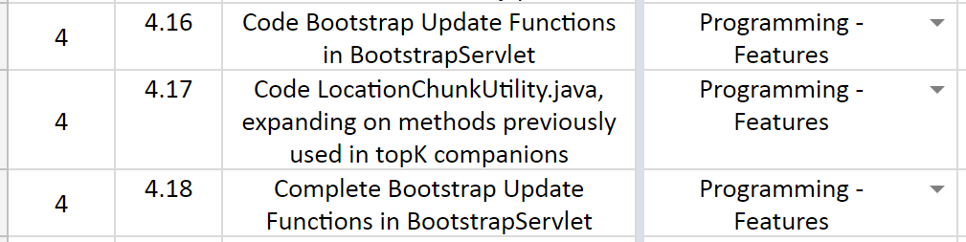
PM IMPROVEMENTS
Detailed Schedule Planning
Breaking tasks down further into sub tasks(e.g Code Bootstrap Update Functions in BootstrapServlet)
Notes:
The start date and end date of each iteration remains the same. The change in schedule is highlighted in red font. Delete Bid JSON is originally in iteration 5. However, due to timetable considerations, we decide to shift it from iteration 5 to iteration 4. We will touch on the reasons for the change later in our presentation.

Slide 6
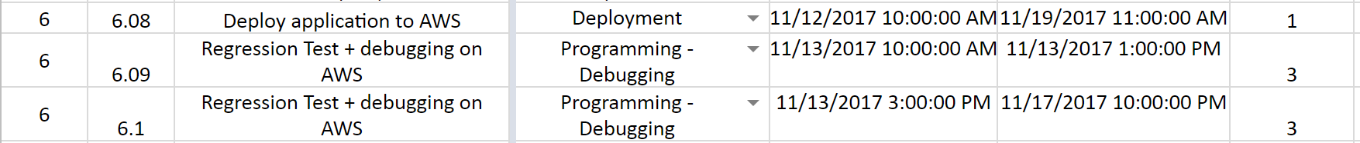
PM IMPROVEMENTS
Detailed Schedule Planning
Planning future iterations in more detail(with specific week/date)
Notes:
The start date and end date of each iteration remains the same. The change in schedule is highlighted in red font. Delete Bid JSON is originally in iteration 5. However, due to timetable considerations, we decide to shift it from iteration 5 to iteration 4. We will touch on the reasons for the change later in our presentation.

Slide 7
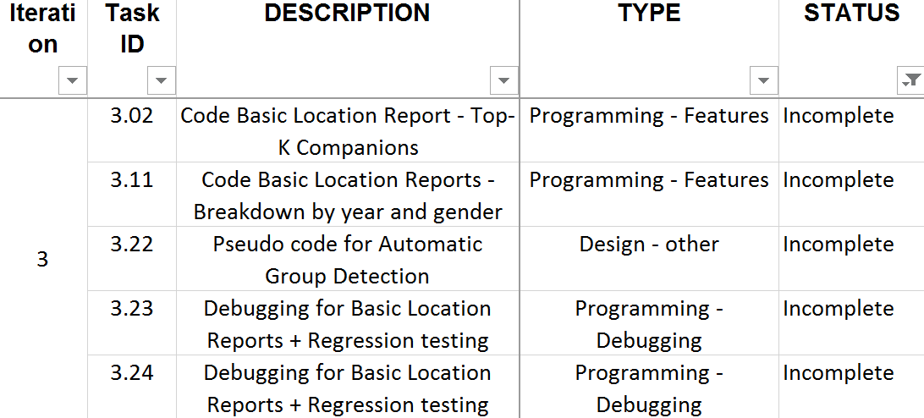
PM IMPROVEMENTS
Detailed Schedule Planning
Better time estimation(balance between under/over plan)
Less unplanned/unfinished tasks
Notes:
The start date and end date of each iteration remains the same. The change in schedule is highlighted in red font. Delete Bid JSON is originally in iteration 5. However, due to timetable considerations, we decide to shift it from iteration 5 to iteration 4. We will touch on the reasons for the change later in our presentation.

Slide 8
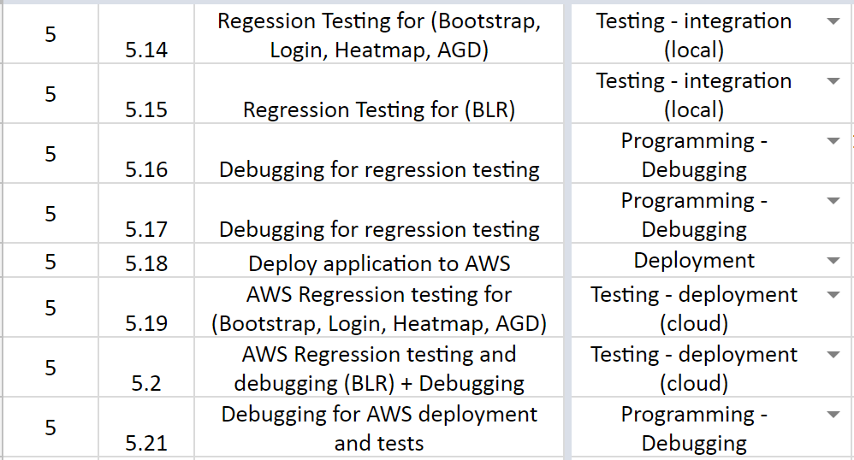
PM IMPROVEMENTS
Debugging Process
Split functionalities testing and debugging session
Added in testing session after AWS deployment (Cloud Deployment Testing)
Notes:
The start date and end date of each iteration remains the same. The change in schedule is highlighted in red font. Delete Bid JSON is originally in iteration 5. However, due to timetable considerations, we decide to shift it from iteration 5 to iteration 4. We will touch on the reasons for the change later in our presentation.

Slide 9
2.
SCHEDULE

Slide 10
Start Date: 9/10/2017
End Date: 22/10/2017
PM: DAVID
Pair 1: Colin & Brit
Pair 2: MingSheng & Zhengren
Iteration 4
TASK | MEMBER ALLOCATION
Design (Technical Documents) Update Class/Sequence Diagrams Update JavaDocs Standardize Test Cases | David
Programming Heatmap Bootstrap Update Location Chunk Utility AGD View Code JSON authentication | TMS & ZR TMS & ZR CBH & GMSB CBH & GMSB CBH & GMSB

Slide 11
Start Date: 9/10/2017
End Date: 22/10/2017
PM: DAVID
Pair 1: Colin & Brit
Pair 2: MingSheng & Zhengren
Iteration 4
TASK | MEMBER ALLOCATION
Test Cases Heatmap Automatic Group Detection | TMS & ZR CBH & GMSB
Debugging Session Top-K Next Place Top-K Companion Heatmap Bootstrap Popular Place | CBH & GMSB TMS & ZR TMS & ZR TMS & ZR CBH & GMSB

Slide 12
Start Date: 23/10/2017
End Date: 5/11/2017
PM: MingSheng
Pair 1: David & Brit
Pair 2: Colin & Zhengren
Iteration 5
TASK | MEMBER ALLOCATION
Design (Technical Documents) Update Diagrams App Demo Milestone Preparation Update JavaDocs | CBH TMS CBH & ZR
Programming AGD Beautify UI Application | DL & GMSB CBH & ZR
Test Cases Automatic Group Detection | CBH & GMSB
Debugging Session AGD | DL & GMSB

Slide 13
Start Date: 9/10/2017
End Date: 22/10/2017
PM: Colin
Pair 1: Colin & MingSheng
Pair 2: David & Zhengren
Iteration 6
TASK | MEMBER ALLOCATION
Design (Technical Documents) Update Diagrams UAT Milestone Preparation | Colin
UAT Debugging Session Login Bootstrap Top-K Companions Top-K Popular Places Breakdown by year and gender Top-K Next Places Heatmap AGD | GBMS & TMS DL & ZR GBMS & TMS DL & ZR GBMS & TMS DL & ZR GBMS & TMS DL & ZR

Slide 14
Start Date: 6/11/2017
End Date: 19/11/2017
PM: Colin
Pair 1: Colin & MingSheng
Pair 2: David & Zhengren
Iteration 6
TASK | MEMBER ALLOCATION
Testing Login Bootstrap Top-K Companions Top-K Popular Places Breakdown by year and gender Top-K Next Places Heatmap AGD | DL & ZR GBMS & TMS DL & ZR GBMS & TMS DL & ZR GBMS & TMS DL & ZR GBMS & TMS

Slide 15
Iteration 7
Start Date: 20/11/2017
End Date: 26/11/2017
PM: DAVID
TASK | MEMBER ALLOCATION
Prepare for Final Presentation | CBH, GBMS, TMS, ZR, DL

Slide 16
3.
CRITICAL PATHS

Slide 17
ITERATION 3
Code Top-k Companion
(1 day)
Create Test case Breakdown & Top-k popular Place (1 day)
Code
Breakdown (1 day)
Code UI (1day)
Code Top-k Place (1day)
(1 days)
Group Meeting (1 day)
Create PM Review Slides (1day)
Update Class Diagrams (1day)
(1 days)

Slide 18
ITERATION 3
Code Test case Top-k Companion Top-k Next Place
(1 day)
Pseudocode Heatmap & Code Breakdown (1 day)
Pseudocode Next Place & Companion (1 day)
Debug BLRS + Regression Test + Deploy to AWS (1day)
Code Top-k Next Place (1day)
Code Top-k Companion (1day)
Pseudocode AGD (1day)
Update Heatmap & Sequence diagrams (1day)
Pseudocode Breakdown & Popular Place (1day)
Pseudocode Breakdown & Popular Place (1day)

Slide 19
ITERATION 4
Debug
Outstanding
bugs (1 day)
Code JSON authentication (1 day)
Integrate JSON authentication into app (1 day)
Code AGD View (1 day)
Code Location Chunk Utility (1 day)
Code Heatmap Function (1day)
Code Bootstrap Update (1day)
(3 days)
Group Meeting (1 day)
Heatmap
& AGD Test case (1day)
(4 days)

Slide 20
ITERATION 4
Test/debug Heatmap
(1 day)
(1 days)
Create Test case JSON Authentication Bootstrap Update (1day)
Test/debug JSON Authentication Bootstrap Update (1day)
Debug BLRS + Regression Test + Deploy to AWS (1day)
Update Sequence diagrams (1day)
Update Javadocs (1day)

Slide 21
ITERATION 5
Code AGD
(1 day)
Test AGD (1 day)
Debug AGD (1 day)
Regression test +
debug (1 day)
Beautify UI (2 days)
(1 day)
Deploy to AWS,
test + debug (1 day)
Update Javadocs
+ metrics
(1 day)
Update diagrams (1day)
(5 days)
Finalize demo
Slides
(1 day)
(5 days)
Group Meeting (1 day)
Code Review (1 day)
(5 days)

Slide 22
ITERATION 6
UAT
Debugging
(3 days)
Regression Testing (1 day)
Group Meeting (1 day)
Debug BLRS + Regression Test + Deploy to AWS (1day)
Update
Documentation (1day)
(3 days)

Slide 23
ITERATION 7
Prepare for Final Presentation
(1 days)
Group Meeting (1 day)
Final Presentation (1day)

Slide 24
4.
METRICS

Slide 25
TASK METRIC
ITERATION | TASKS PLANNED | TASKS COMPLETED | TM SCORE
1 | 11 | 11 | 100%
2 | 21 | 23 | 109.52%
3 | 22 | 24 | 109.09%
4 | 31 | 31 | 100%

Slide 26
BUG METRIC
Formula: 1 x num (low) + 5 x num (high) + 10 x num (critical)
ITERATION | LOW IMPACT | HIGH IMPACT | CRITICAL IMPACT | Total Bugs | BUG METRIC
2 | 3 | 2 | 1 | 6 | 23
3 | 3 | 7 | 2 | 12 | 58
4 | 6 | 8 | 0 | 14 | 46

Slide 27
5.
ROLES ROTATION PLAN

Slide 28
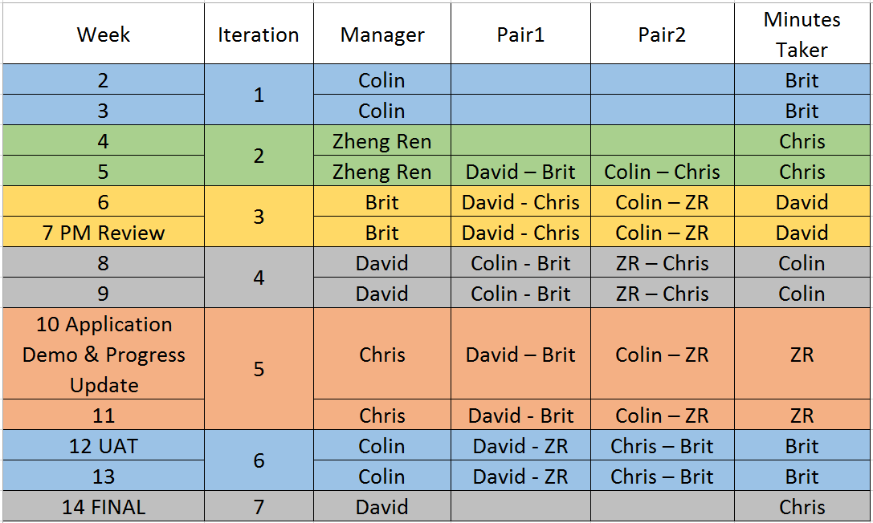
ROLE ROTATION PLAN

Slide 29
THANK YOU

